Slide 1

Blockchains
& Distributed Ledgers
Lecture 10
Aggelos Kiayias
Slide credits: AK, Dimitris Karakostas

Slide 2
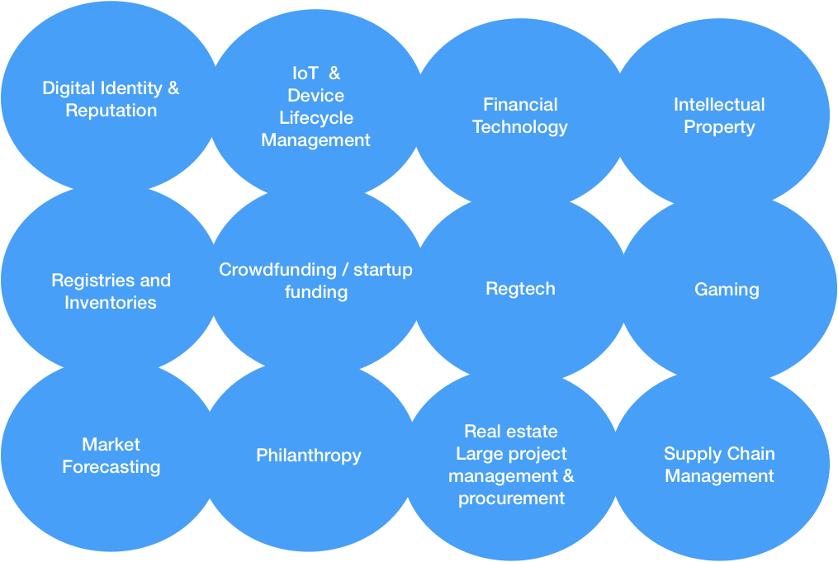
(Possible) Applications of DLT

Slide 3
Use an independent DL or piggyback on existing?
Scheme | Advantage | Disadvantage
Piggybacking | Potential for higher assurance | Need to engineer or program protocol rules into existing ledger
Independent | Ability to customise protocol & enforce individual properties | Might attract a small set of initial nodes and initially be less trustworthy

Slide 4
Comparison of different blockchains
Blockchain | Mode of operation | Smart Contract Capability | Account Model | Notes
Bitcoin | Proof of Work | Limited / Bitcoin script | UTXO model | High energy consumption. First bid pricing.
Ethereum | Proof of Stake | General / Ethereum VM | Account based | Minimal energy consumption. Variable fees.
Cardano | Proof of Stake | General / Plutus scripts | Extended UTXO model | Minimal energy consumption. Fixed fees.
Solana | Proof of History | EVM compatible | Account based | Modest energy consumption. Priority fees.

Slide 5
Layer 2 solutions
Blockchain “layer 1”’s do not scale well
Throughput - transaction per second (TPS)
Latency – fast confirmation
Layer 2 solutions :
modify some of the availability / safety characteristics of layer 1 in favor of better scaling
Resort to a layer 1, when disputes / problems arise.
Opportunities
L2 that interoperate across L1 chains
“hybrid Dapps” that operate with different L1’s

Slide 6
Piggybacking Example - Coloured Coins
Even though Bitcoin can be treated as fungible, it is not:
the smallest Bitcoin denomination (satoshi) can be tracked following some convention
“Colouring" outputs so they represent specific assets
output1
tx
output2
output3

Slide 7
Piggybacking Example - Coloured Coins
Use of the OP_RETURN opcode
OP_RETURN signifies that a transaction output is invalid (and unspendable)
Can be followed by 80 bytes of data
Paying to an OP_RETURN enables storing personal data on the blockchain
Burn one output to define colouring information for the (rest of the) transaction
Bitcoin transaction fees still apply
transactions have to be formed with OP_RETURN
a small amount of storage permitted
The secret-key of the coloured account controls asset ownership
Marker outputs (via OP_RETURN) can be used to further specify quantities transferred etc
Accounts should hold a balance to ensure the ability to transfer them onwards

Slide 8
Piggybacking Example - Coloured Coins
Bitcoin miners do not enforce proper rules of colouring
Coloured transactions are treated as regular transactions by “colour-blind” miners
Colouring rules might not be respected by an indifferent or malicious miner
Parsing algorithms for colours should take this into account

Slide 9
Applications

Slide 10
Digital economy (on a blockchain)
Use a blockchain to record monetary transactions
Create new money based on pre-determined algorithm

Slide 11
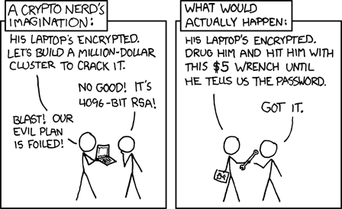
Digital economy (on a blockchain)
Use a blockchain to record monetary transactions
Create new money based on pre-determined algorithm Issues
Why would people use on-chain tokens as money instead of as commodities? Why would someone sell BTC, if they expect its (USD) price to increase?
How to accurately valuate a blockchain-based economy? (e.g., market capitalization)

Slide 12
Name registry (on a blockchain)
Use a blockchain to register names
Useful in the context of DNS (domain name system) and public-key directories
Censorship-resistant
Examples:
Namecoin: separate blockchain, based on Bitcoin protocol
Blockstack: piggybacking on the Bitcoin blockchain, compare to coloured coins
ENS (Ethereum Name Service): domain registry implemented as an Ethereum smart contract

Slide 13
Name registry (on a blockchain)
Use a blockchain to register names
Useful in the context of DNS (domain name system) and public-key directories
Censorship-resistant
Examples:
Namecoin: separate blockchain, based on Bitcoin protocol
Blockstack: piggybacking on the Bitcoin blockchain, as in the case of colored coins
ENS (Ethereum Name Service): domain registry implemented as an Ethereum smart contract
Issues
How to connect blockchain-issued names with the rest of the internet?
What if some domains should be taken down?

Slide 14
Land ownership (on a blockchain)
Issue a new digital asset linked to land title
Store information in the digital asset that links to an information resource
E.g., insert a URL to real-world registry or an identifier for a torrent file
Digital asset becomes representation of ownership
He who controls the asset can prove or transfer ownership of the linked land
Same idea can be extended to any real-world asset

Slide 15
Land ownership (on a blockchain)
Issue a new digital asset linked to land title
Store information in the digital asset that links to an information resource
E.g., insert a URL to real-world registry or an identifier for a torrent file
Digital asset becomes representation of ownership
He who controls the asset can prove or transfer ownership of the linked land
Same idea can be extended to any real-world asset
Issues
What happens if the information source is no longer available (e.g., the URL breaks)?
What if the legal system does not recognize on-chain representation?

Slide 16
Gaming and art collection (on a blockchain)
In-game currency on a blockchain
E.g., Ethereum-based game tokens
Digital collectibles
E.g., trading cards, virtual animans (CryptoKitties), NFTs (Non-Fungible Tokens) of art works
On-chain games
Gambling, strategy games, social network games, ...

Slide 17
Gaming and art collection (on a blockchain)
In-game currency on a blockchain
E.g., Ethereum-based game tokens
Digital collectibles
E.g., trading cards, virtual animans (CryptoKitties), NFTs (Non-Fungible Tokens) of art works
On-chain games
Gambling, strategy games, social network games, ...
Issues
Gaming companies typically want control of in-game economy - why would decentralization benefit them?
If some aspects are off-chain (e.g., game graphics or real-world art work), what happens if the company does not support the token system anymore?
Why would users pay fees to play, when centralized options are free (or, at worst, pay-to-win)?

Slide 18
Supply chain tracking (on a blockchain)
Real-world products
E.g., clothes, shoes, meat, olive oil, even diamonds
Create a digital fingerprint of the object
Register the fingerprint on a blockchain
Record every change in the object’s state
E.g., creation at source, transportation, selling/buying

Slide 19
Supply chain tracking (on a blockchain)
Real-world products
E.g., clothes, shoes, meat, olive oil, even diamonds
Create a digital fingerprint of the object
Register the fingerprint on a blockchain
Record every change in the object’s state
E.g., creation at source, transportation, selling/buying
Issues
How to create a fingerprint (unique digital representation) of a physical object?
How to make sure that people that handle the object actually record its state changes properly?

Slide 20
Philanthropy (on a blockchain)
An NGO/philanthropic organization creates a smart contract
E.g., to collect funds for building a school
People send funds to the contract
The contract keeps the funds in escrow:
When a proof that the project is complete is provided, the contract releases the funds
If a deadline passes, the remaining funds are returned to the participants

Slide 21
Philanthropy (on a blockchain)
An NGO/philanthropic organization creates a smart contract
E.g., to collect funds for building a school
People send funds to the contract
The contract keeps the funds in escrow:
When a proof that the project is complete is provided, the contract releases the funds
If a deadline passes, the remaining funds are returned to the participants
Issues
What kind of (secure) proofs of real-world actions could be understandable by a smart contract?
How can you prevent embezzlement, i.e., a corrupted official publishing incorrect proofs?

Slide 22
Prediction Markets
A market that enables trading on future events
Oracles provide real-world information on whether an event occurred
Example: “10 tornadoes will hit USA in 2020”
participants bet in favour or against the event
market shares: YES = α, NO = 1-α; total investment: X; probability of event happening: p
YES (NO) participants receive X iff event (doesn’t) happen. Expected Profit of YES = pX - αΧ
Use prediction markes for:
Gambling, insurance purposes, ...

Slide 23
Prediction Markets
A market that enables trading on future events
Oracles provide real-world information on whether an event occurred
Example: “10 tornadoes will hit USA in 2020”
participants bet in favour or against the event
market shares: YES = α, NO = 1-α; total investment: X; probability of event happening: p
expected Profit of YES = pX - αΧ
Use prediction markets for:
Gambling, insurance purposes, ...
Issues
Trust in the oracle? Can a decentralized oracle for real-world information exist?
Statements may not have a well-defined truthvalue (e.g., “Puerto Rico is part of the USA”)

Slide 24
IoT and micropayments (on a blockchain)
IoT devices connected to the internet
E.g., smart fridges, sensors
Utility meters
E.g., electricity or water consumption
User pays in real-time with multiple “micro”-payments to the service provider
Alternative to subscription model
Monetization of user data: User gets income for selling their personal data

Slide 25
IoT and micropayments (on a blockchain)
IoT devices connected to the internet
E.g., smart fridges, sensors
Utility meters
E.g., electricity or water consumption
User pays in real-time with multiple “micro”-payments to the service provider
Alternative to subscription model
Monetization of user data: User gets income for selling their personal data
Issues
Scaling - fees can increase dramatically near congestion
Privacy - why would you share your daily data with the whole world?
Even if you got paid for it, would you want to sell your personal life?

Slide 26
Crowdfunding (on a blockchain)
A project creates a smart contract that issues tokens
Initial Coin Offering (ICO), ERC20 Ethereum tokens
Users give coins in exchange for tokens
Buy tokens with ETH
Tokens can:
Be used in a future platform that the project creates (utility tokens)
Be used as investment, speculation, (securities)

Slide 27
Crowdfunding (on a blockchain)
A project creates a smart contract that issues tokens
Initial Coin Offering (ICO), ERC20 Ethereum tokens
Users give coins in exchange for tokens
Buy tokens with ETH
Tokens can:
Be used in a future platform that the project creates (utility tokens)
Be used as investment, resold, offer yield (securities)
Issues
How to guarantee that project will not run away with the funds (i.e., exit scam)?
What if promoters scam investors and authorities, e.g., via a pump and dump?
Are the promises of the project verified/regulated? Will the project face penalties for lying?

Slide 28
Market Capitalization

Slide 29
Market capitalization (of cryptocurrencies)
Centralized exchanges are sources of price
Price of X: the latest price for which a single X token was sold (in exchange for USD/GBP/Bitcoin/altcoins/…)
Market cap: <number of coins in circulation> ᐧ <price>

Slide 30


💰💰💰
Product name | Circulating Tokens | Price | Market Cap | Total MC

Slide 31
1 BTC
💰💰💰
Product name | Circulating Tokens | Price | Market Cap | Total MC
Bitcoin | 1

Slide 32
Sell 1 BTC for $1
1 BTC
💰💰💰
Product name | Circulating Tokens | Price | Market Cap | Total MC
Bitcoin | 1

Slide 33
$1
1 BTC
Product name | Circulating Tokens | Price | Market Cap | Total MC
Bitcoin | 1 | $1 | $1 | $1

Slide 34

$1
1 BTC
1 ETH
Product name | Circulating Tokens | Price | Market Cap | Total MC
Bitcoin | 1 | $1 | $1 | $1
Ethereum | 1

Slide 35
Sell 1 ETH
for 1 BTC
$1
1 BTC
1 ETH
Product name | Circulating Tokens | Price | Market Cap | Total MC
Bitcoin | 1 | $1 | $1 | $1
Ethereum | 1

Slide 36
$1
1 ETH
1 BTC
Product name | Circulating Tokens | Price | Market Cap | Total MC
Bitcoin | 1 | $1 | $1 | $2
Ethereum | 1 | $1 (1 ETH=1BTC) | $1

Slide 37
Buy 0.5 ETH
for 1 BTC
$1
1 ETH
1 BTC
Product name | Circulating Tokens | Price | Market Cap | Total MC
Bitcoin | 1 | $1 | $1 | $2
Ethereum | 1 | $1 | $1

Slide 38
$1
0.5 ETH,
1 BTC
0.5 ETH
Product name | Circulating Tokens | Price | Market Cap | Total MC
Bitcoin | 1 | $1 | $1 | $3
Ethereum | 1 | $2 (1ETH=2BTC) | $2

Slide 39
Buy 0.5 BTC for $1
$1
0.5 ETH,
1 BTC
0.5 ETH
Product name | Circulating Tokens | Price | Market Cap | Total MC
Bitcoin | 1 | $1 | $1 | $3
Ethereum | 1 | $2 | $2

Slide 40
0.5 BTC
0.5 ETH,
0.5 BTC,
$1
0.5 ETH
Product name | Circulating Tokens | Price | Market Cap | Total MC
Bitcoin | 1 | $2 | $2 | $6
Ethereum | 1 | $4 | $4

Slide 41
0.5 BTC
0.5 ETH,
0.5 BTC,
$1
0.5 ETH
Product name | Circulating Tokens | Price | Market Cap | Total MC
Bitcoin | 1000 | $2 | $2000 | $6000
Ethereum | 1000 | $4 | $4000

Slide 42
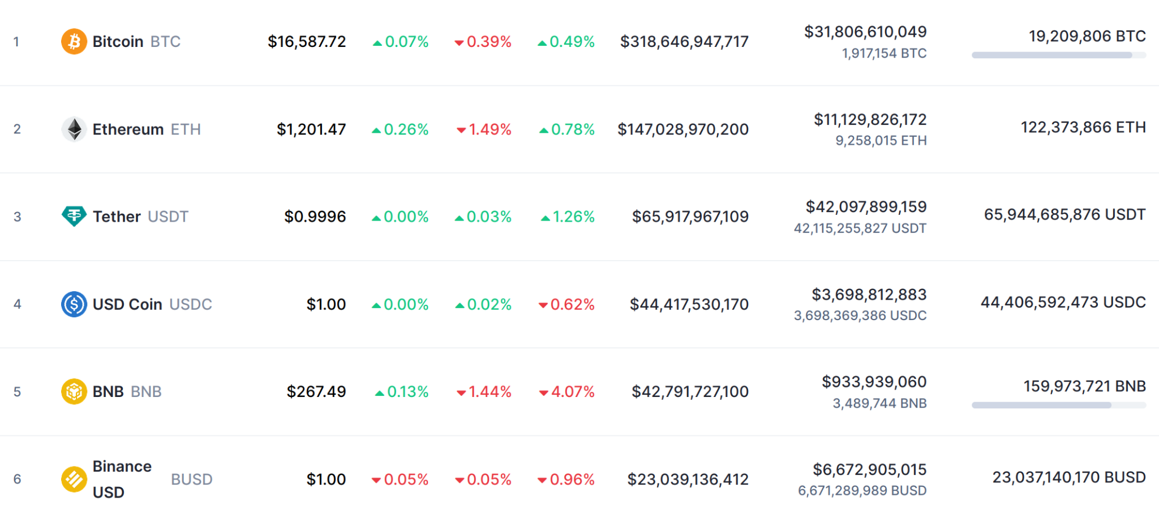
11/2022

Slide 43
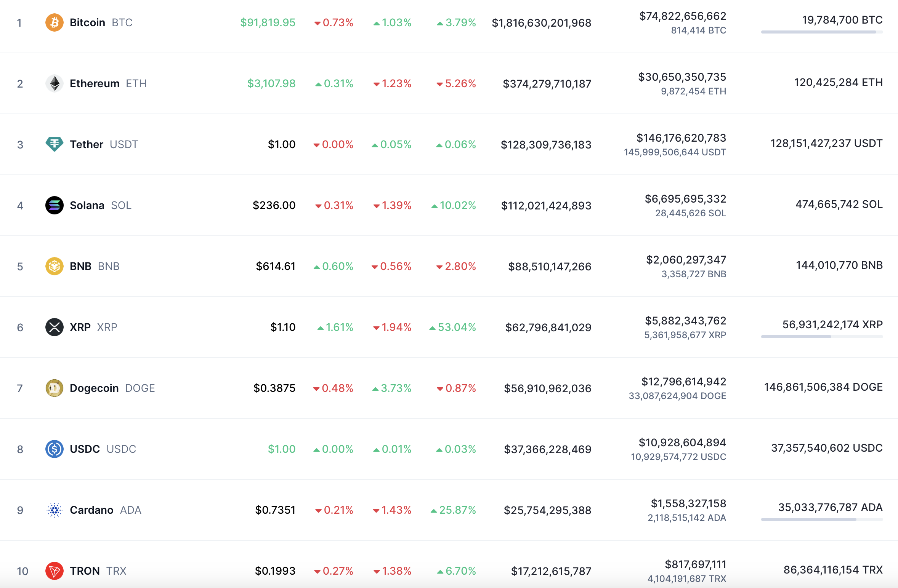
https://coinmarketcap.com
20/11/2024

Slide 44
Market capitalization (of cryptocurrencies)
Centralized exchanges are sources of price
Price of X: the latest price for which a single X token was sold (in exchange for USD/GBP/Bitcoin/altcoins/…)
Market cap: <number of coins in circulation> x <price> Issues
Market cap may be artificially increased
E.g., tokens or dubious “coins” sold for other cryptocurrency
Question: What is the ratio of real-world money to market cap? In other words, how much real-world money is actually in the market?

Slide 45
Decentralized Finance

Slide 46
Finance
{creation, management, investment} of money and financial assets
Financial assets: non-physical assets whose value is derived by contractual claim
Bank deposits, stocks, bonds, loans
Financial services
Lending/borrowing, issuing securities, managing funds
Financial markets: marketplaces for trading financial assets

Slide 47
Decentralized Finance (DeFi)
Financial products and services on decentralized infrastructure
Do not rely on centralized intermediaries
E.g., exchanges, banks, brokers
Utilize the security of an underlying blockchain system
Open to hazards and attacks that stem from public/decentralized nature of blockchains

Slide 48
Securities
Security: a fungible, negotiable, financial instrument that has some value
stock (representing ownership of company) - equity security
bond (representing a creditor relationship with company/government) - debt security
In the US (cf. Securities and Exchange Commission (SEC) v. W.J. Howey Co) a security is:
a contract, transaction, or scheme whereby a person invests his money in a common enterprise...
Horizontal commonality: Investors’ assets are joined and they share the risk and benefits
Vertical commonality: Investors’ fortunes are linked and dependent upon the efforts of those seeking the investment (narrow (investors’ profits rise and fall together with promoter’s) vs. broad (investors’ profits depend on promoter’s expertise and performance))
… and is led to expect profits solely from the efforts of the promoter or a third party

Slide 49
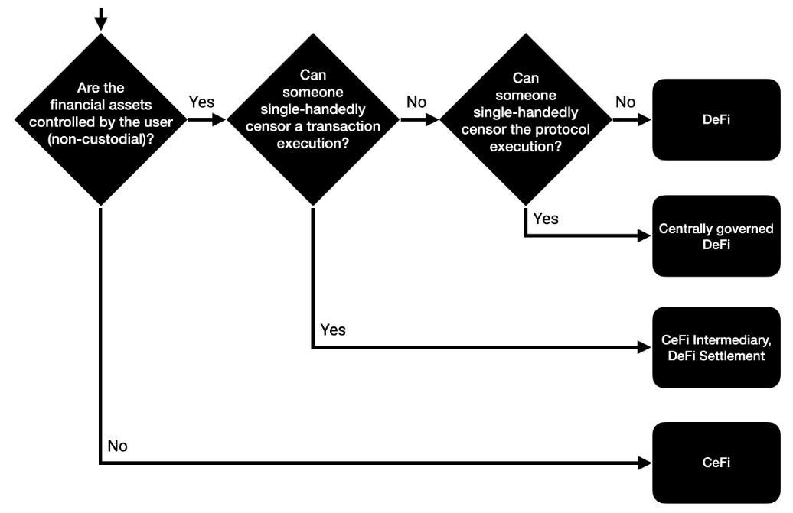
Decentralized Finance (DeFi)
Source: https://berkeley-defi.github.io/f21

Slide 50
Exchanges/Marketplaces
Exchange
Want: 5 ETH
Want: 1 BTC
Have: 1 BTC
Have: 3 ETH
Want: 1 BTC
Have: 4 ETH

Slide 51
Decentralized Exchanges (DEXs)
Completely on-chain
Trades between native chain currency (e.g., ETH) and on-chain tokens (e.g., ERC20)
Censorship resistance
Availability depends on underlying blockchain’s safety & liveness
Differences from centralized (server-based) exchanges
(Blockchain) fees for creating orders
(Blockchain) fees for cancelled orders
Slower matching
No KYC and AML provisions

Slide 52
Order book based Exchange
Pair X-Y
spread
-∞
price
asks
Sell orders
+∞
bids
buy orders
max bid
min ask

Slide 53
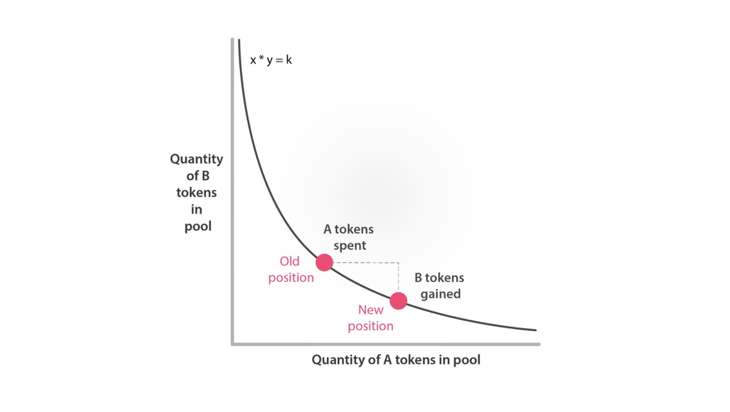
Automated Market Makers
A-B pair
a A
b B
Invariant a * b = k
Buy A tokens with b’ amount of B tokens
New state (a-a’)*(b+b’) = c ⬄ a’ = ab’/(b + b’)
If a’<<a and b’<<b then a’ ~= b’ (a/b)
(but can be far from a/b otherwise)
“Liquidity providers” are incentivized to keep a,b big

Slide 54
Exchange attacks
Front-running
Adversary can use gas price to front-run a trading tx
Miners choose tx ordering → can front-run plain users
Also exists in centralized exchanges (esp. if unregulated)
Exchange owner can see all txs, control execution order, and increase/decrease price arbitrarily to “burn” customers (both short and long)
Some mining pools offer front-running as a feature (e.g., Ethermine)

Slide 55
Decentralized Exchanges (DEXs), Attacks
Front-running
Adversary can use gas price to front-run a trading tx
Miners choose tx ordering → can front-run plain users
Also exists in centralized exchanges (esp. if unregulated)
Exchange owner can see all txs, control execution order, and increase/decrease price arbitrarily to “burn” customers (both short and long)
Some mining pools offer front-running as a feature (e.g., Ethermine)
Insertion (aka sandwich) attack
U creates a “buy” order TX_{U}, e.g., buy BTC for ETH (expectation: BTC-ETH will go up)
Attacker inserts before TX_{U} (front-running) another buy order and gets x BTC for y₁ ETH, moving the price of BTC-ETH up
U’s order is executed for the increased price
Attacker inserts a sell order for BTC-ETH after TX_{U}, which gets back y₂ ETH for x BTC
Attack profit: y₂ - y₁ > 0

Slide 56
(Real-world) Loans
Request loan for $x
Borrower
Lender (Bank)

Slide 57
(Real-world) Loans
Request loan for $x
Check, estimate default risk, (perhaps) require collateral
Borrower
Lender (Bank)

Slide 58
(Real-world) Loans
Request loan for $x
Check, estimate default risk, (perhaps) require collateral
Give out loan of $x with y interest (y ~ risk)
Borrower
Lender (Bank)

Slide 59
(Real-world) Loans
Request loan for $x
Check, estimate default risk, (perhaps) require collateral
Give out loan of $x with y interest (y ~ risk)
Pay back $(x + y) or default (pay back less than x+y)
Lender (Bank)
Borrower

Slide 60
Decentralized Loans
Assumption: Oracle that reports (real-world) asset prices
E.g., USD prices
Typically semi or completely centralized
Lender deposits principal capital to a “vault”
The vault is simply the service’s smart contract
Borrower deposits collateral to borrow from vault
Typically over-collateralized: value(collateral) (in real prices) > value(loan)
If collateral value drops significantly, loan can be automatically liquidated
Liquidator repays debt and gets the collateral at a discount
Borrower returns loan + interest to vault
Lender can withdraw principal capital and received interest

Slide 61
Flash Loans
A loan that occurs in a single atomic transaction
Lender adds principal capital (“liquidity”) to a smart contract pool
Within a single transaction:
Smart contract pool transfers x assets from the pool to borrower’s account
Borrower uses x assets as they want
Borrower transfers x assets plus some fee to the pool
If any step of the above fails (e.g., borrower cannot repay the pool), tx fails
No default risk!

Slide 62
Decentralized/Flash Loans, Attacks
Price oracle manipulation
Control collateral requirements

Slide 63
Decentralized/Flash Loans, Attacks
Price oracle manipulation
Control collateral requirements
Risk-free arbitrage
DEXs may offer different prices on the same trading pair
Use flash loan to:
i) buy on one DEX
ii) sell on the other (at higher price)
iii) repay loan+fees and profit depending on price difference

Slide 64
Decentralized/Flash Loans, Attacks
Price oracle manipulation
Control collateral requirements
Risk-free arbitrage
DEXs may offer different prices on the same trading pair
Use flash loan to:
i) buy on one DEX
ii) sell on the other (at higher price)
iii) repay loan+fees and profit depending on price difference
Washtrading
Sell and buy the same asset to create misleading activity, e.g., to artificially increase trading volume and show “demand”
Centralized cryptocurrency exchanges often perform washtrading (e.g., [1, 2, 3])
Illegal in USA regulated markets since 1936

Slide 65
Stablecoins

Slide 66
Fiat-backed stablecoins
Centralized issuer of “stable price” tokens
How it works
User deposits $1 to service’s bank account
Service issues 1 token in exchange
As long as token remains in circulation, the service keeps $1 in escrow
Whenever user wants, they can redeem 1 token for $1
Why use such stablecoins instead of USD directly?
Exchanges
Simplify regulation compliance
settle inter-exchange transfers fast
Users
Engage in DeFi
bypass capital controls
avoid KYC/AML requirements

Slide 67
Fiat-backed stablecoins
If 1-1 promise (silently) breaks
Service issues loans (fractional reserve), assuming default risk
Service can insert (artificial) liquidity into the market (to pump price/market cap of assets)
If regulation tightens
The broken 1-1 promise becomes public knowledge
Trust in the system decreases, “stable” price no longer stable (reflecting default risk)
Liquidity evaporates due to “firesale” of stablecoin
Tether (by far the largest “stablecoin”)
Opaque (no audits, unknown reserves, unknown affiliations, can refuse redemptions at will)
misleading behaviour (NYAG, CFTC)
It is known that Tether does not have $1 for every USDT
Circulation: $4B till 2019, $21B 12/2020, $74B in 11/2021, $65.9B in 11/2022, $132B 11/2024
“Daily trading volume” across all exchanges: $171B (>2x Bitcoin’s)
Almost every major exchange trades Tether (and is open to Tether collapse risk)

Slide 68
Crypto-backed stablecoins
(1+x)-1 backing by crypto reserves
(Centralized) price oracles
How it works
Assume: 1 ETH = $1, x = 1
Deposit 2 ETH and mint 1 stablecoin (over-collateralized)
If price(ETH) > $0.5: stablecoin’s price unchanged
If price(ETH) < $0.5: stablecoin liquidated, investor receives 2 ETH
Example: Dai

Slide 69
Crypto-backed stablecoins
Leveraged investment
Mint 1 coin with 2 ETH
Buy 1 ETH with 1 coin (price of ETH is $1)
Increased demand for ETH → ETH price ↑
ETH price ↑ (eg. 1 ETH = $2)→sell 0.5 ETH for 1 coin, redeem coin for 2 ETH (profit: 0.5 ETH)
Go to (a) (price pump)
What if ETH price drops?
Stablecoins liquidated for ETH
Investors sell ETH to cut losses → Uncertainty from liquidations, ETH supply ↑ → price ↓
Go to (a) (death spiral)
Example: March 2020, MakerDAO had to centrally intervene and inject liquidity to avoid complete shutdown
What happens if market collapses and external pockets not deep enough?

Slide 70
Algorithmic stablecoins
(Premise) a price oracle
Two types of assets
“stable” coins
bonds
How it works
coin price > $1: automatically issue and distribute new coins (coin supply ↑ → price ↓)
coin price < $1: sell bonds for coins (coin supply ↓ → price ↑)
Bonds:
Buy bond in auction (face value: $1, auction price: y)
If coin price gets above $1 again, redeem bond to receive new coins (profit = 1 - y)
* Irving Fisher. “The Purchasing Power of Money” (1911)
Notes:
velocity of money, that is the average frequency across all transactions with which a unit of money is spent. This reflects availability of financial institutions, economic variables, and choices made as to how fast people turn over their money.

Slide 71
Algorithmic stablecoins
No such project has survived for long
Nubits (“World's Best Stable Digital Currencies”): $0.12
Basis (“an Algorithmic Stablecoin Pegged to 1 USD”): $0.04
Terra (“stable rewards in all economic conditions”): $0.02
Why fail?
price ↑ → bond-holders and investors receive newly minted coins
price ↓ → investors can only buy bonds and have faith that price will go up again
if price does not go up quickly
lost profit (opportunity cost) ↑
if lost profit > bond profit, no reason to remain invested

Slide 72
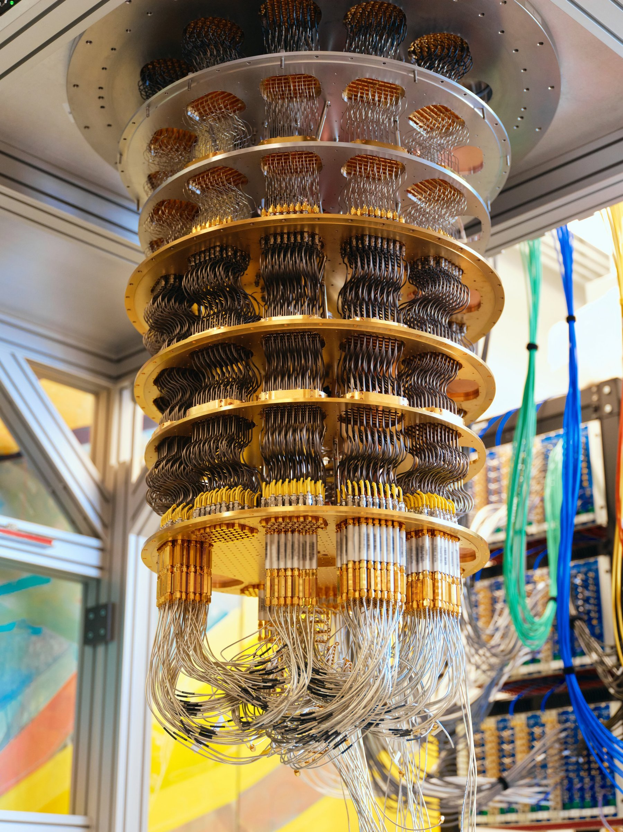
Post quantum cryptography.
Quantum computers might be around the corner.
What does it mean for security?

Slide 73
PoW systems vs. PoS systems
PoW consensus remains secure but the adversary will obtain a quadratic speedup; moreover,
Using discrete-log based signatures would enable the quantum adversary to issue on the user’s behalf a double spend transaction.
PoS
Consensus mechanisms that operate under the assumption that honest majority of stake as distributed to participants. A quantum adversary may recover those keys.
Mitigation:” develop post-quantum secure cryptographic schemes

Slide 74
References
Philip Daian et al. “Flash Boys 2.0: Frontrunning in Decentralized Exchanges, Miner Extractable Value, and Consensus Instability” 2020
Eskandari S., Moosavi S., Clark J. “SoK: Transparent Dishonesty: Front-Running Attacks on Blockchain” 2019
Qin, K., Zhou, L., Livshits, B. and Gervais, A. “Attacking the defi ecosystem with flash loans for fun and profit” 2021
Douglas Arner, Raphael Auer and Jon Frost. “Stablecoins: risks, potential and regulation” 2020
Golumbia, David. “The politics of Bitcoin: software as right-wing extremism” 2016
David Graeber. “Debt: The first 5000 years” 2012
Robert Skidelsky. “Money and Government: A Challenge to Mainstream Economics” 2018

